Slide 1
Matrix Math in Excel
Week 3, Day 12

Slide 2

Matrix Usage
A matrix is a rectangular grid of numbers, called elements, usually referred to with a capital letter
Elements are referred to by the lower-case variable letter used to refer to the whole matrix and subscripts of the row and column
Enter each element in its own cell in Excel spreadsheet
Use “Draw Border” tool (in Font section of Home tab) to draw thick lines to either side as pictured above
A matrix with “1”s along the diagonal (i₁₁, i₂₂, etc.) and “0”s everywhere else is called the “identity matrix”, I
$$A=\left|\begin{matrix}a_{11} & a_{12} \\ a_{21} & a_{22} \\ a_{31} & a_{32}\end{matrix}\right|$$

Slide 3
Matrix Addition
To add matrices, their dimensions (# of rows & # of columns) must be identical
Each element in the result matrix is the sum of the corresponding elements in each added matrix
To add matrices in Excel, just copy the formula adding the elements to every cell in the result matrix.

Slide 4
Matrix Multiplication
To multiply a matrix by a scalar number, multiply each element by the scalar
To multiply matrices, the # of rows in the first matrix must be the same as the # of columns in the second
Ex: You can multiply a 3x3 matrix by a 3x1 vector. You cannot multiply a 3x2 matrix by a 3x3 matrix
The result matrix will have a # of rows equal to the # of rows in the first matrix and a # of columns equal to the # of columns in the second matrix.
Ex: Multiplying a 3x3 matrix by a 3x1 vector gives a 3x1 result vector. Multiplying a 3x2 matrix by a 2x4 matrix gives a 3x4 matrix result.
Matrix multiplication is NOT commutative!

Slide 5
Matrix Multiplication in Excel
Create the two matrices to be multiplied
Highlight a group of cells of the proper dimensions to contain the result matrix
Select the MMULT function from the Math & Trig drop-down menu in the Function Library on the Formulas tab.
Highlight the range of cells containing each matrix to be multiplied
Press Ctrl+Shift+Enter to create an “array formula” in every cell of the result matrix

Slide 6
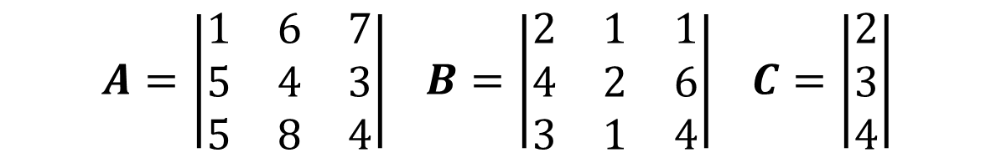
In-Class Exercise #8
Use matrix mathematics on the three following matrices:
Add the two matrices: A + B = D
Multiply the matrix A by the vector C: A C = E
Multiply the two matrices A & B: A B = F
$$A=\left|\begin{matrix}1 & 6 & 7 \\ 5 & 4 & 3 \\ 5 & 8 & 4\end{matrix}\right| B=\left|\begin{matrix}2 & 1 & 1 \\ 4 & 2 & 6 \\ 3 & 1 & 4\end{matrix}\right| C=\left|\begin{matrix}2 \\ 3 \\ 4\end{matrix}\right|$$

Slide 7
Matrix Inversion in Excel
A matrix can be inverted. The inverse of a matrix, A, is denoted A⁻¹. The definition of the inverse is that A A⁻¹ = I ONLY square matrices can be inverted!
To invert a matrix in Excel:
Enter the matrix into the spreadsheet
Select a group of cells the same shape to contain the inverted matrix
Select the MINVERSE function and select the original matrix as the argument
Press Ctrl+Shift+Enter

Slide 8

In-Class Exercise #9
Invert the following matrix, then multiply it by its inverse to prove A A⁻¹ = I
$$A=\left|\begin{matrix}1 & 0 & 3 \\ 2 & 1 & 1 \\ 2 & 3 & 1\end{matrix}\right|$$

Slide 9
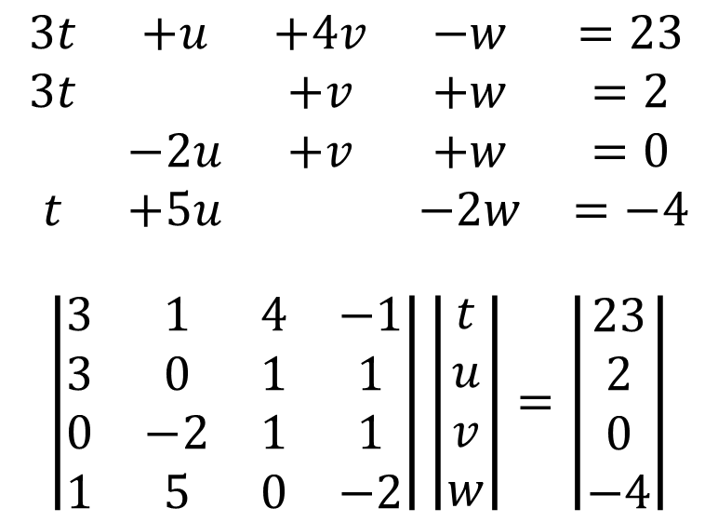
Matrix Operations for Simultaneous Linear Equations
A set of simultaneous linear equations can be represented in matrix form as follows:
To solve the problem, multiply the inverse of the coefficients matrix by the “answer” vector
$$\begin{matrix}3t & +u & +4v & −w & =23 \\ 3t & & +v & +w & =2 \\ & −2u & +v & +w & =0 \\ t & +5u & & −2w & =−4\end{matrix}$$ $$\left|\begin{matrix}3 & 1 & 4 & −1 \\ 3 & 0 & 1 & 1 \\ 0 & −2 & 1 & 1 \\ 1 & 5 & 0 & −2\end{matrix}\right|\left|\begin{matrix}t \\ u \\ v \\ w\end{matrix}\right|=\left|\begin{matrix}23 \\ 2 \\ 0 \\ −4\end{matrix}\right|$$

Slide 10

In-Class Exercise #10
Use matrix mathematics to solve the same system of linear equations as In-Class Exercise #7
$$3t+u+4v−w−23=0 \\ 3t+v+w−2=0 \\ −2u+v+w=0 \\ t+5u−2w+4=0$$

